Slide 1

Module 8: Tree-Based Methods
Nov 5th, 2021

Slide 2
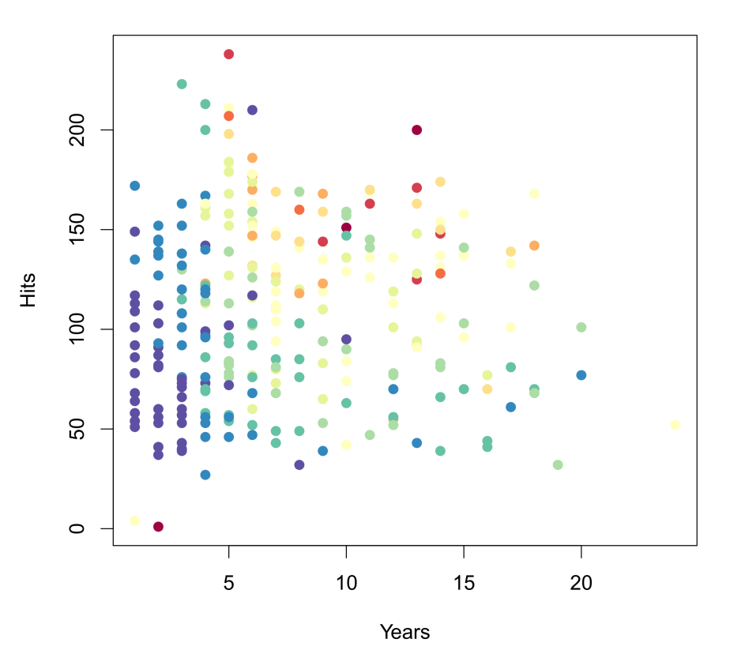
Example: Baseball Salary Data
Salary is color from low (blue) to high (red)

Slide 3
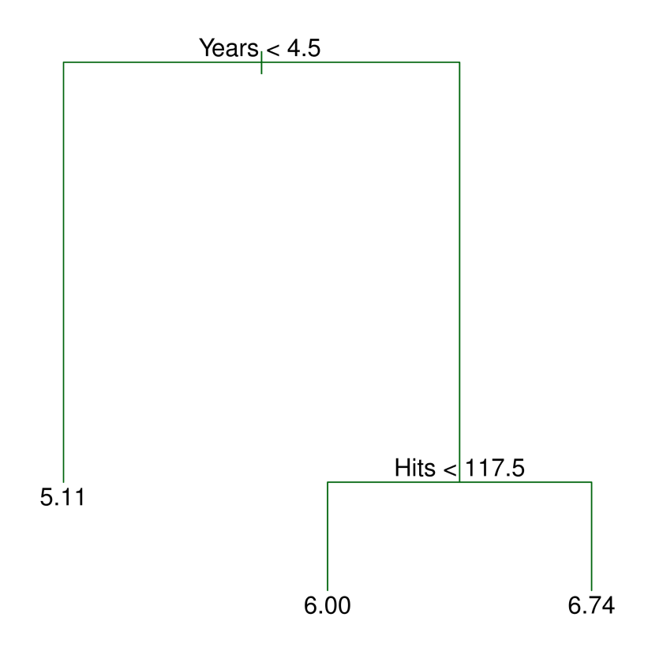
Decision Tree

Slide 4
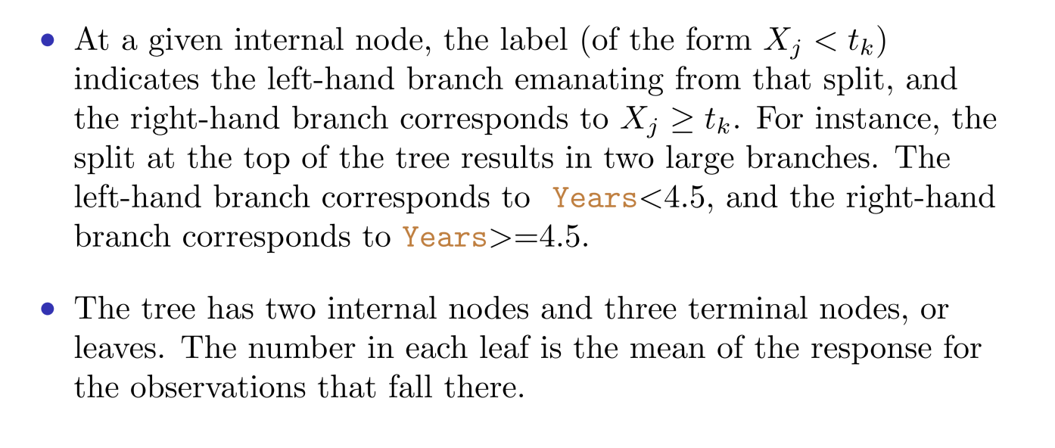
Interpretation

Slide 5
Interpretation
Year is the most important factor.
Given a player is less experienced, the # of hits seems to be not important.
Given player with more than 4.5 years in the league, # of hits will positively correlate with salary .
Compared with OLS and Spline?

Slide 6
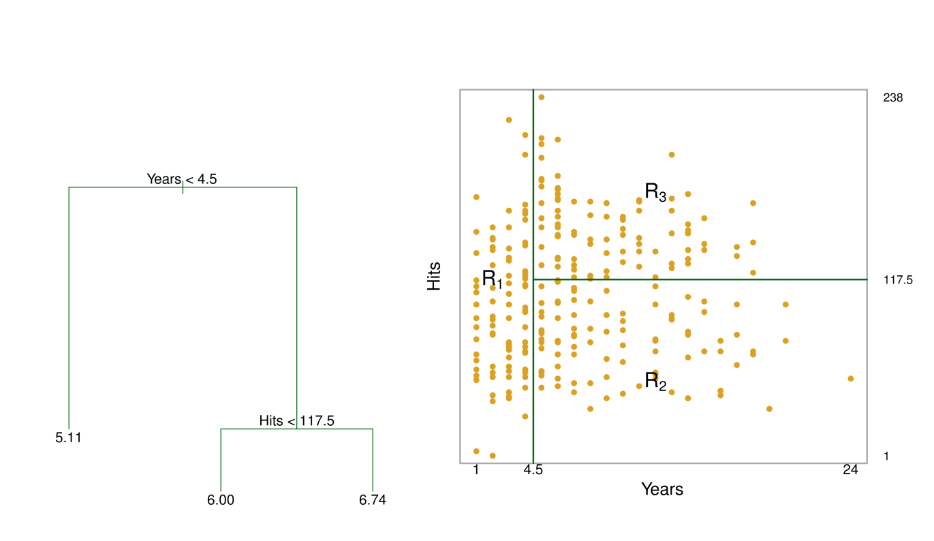
Interpretation

Slide 7
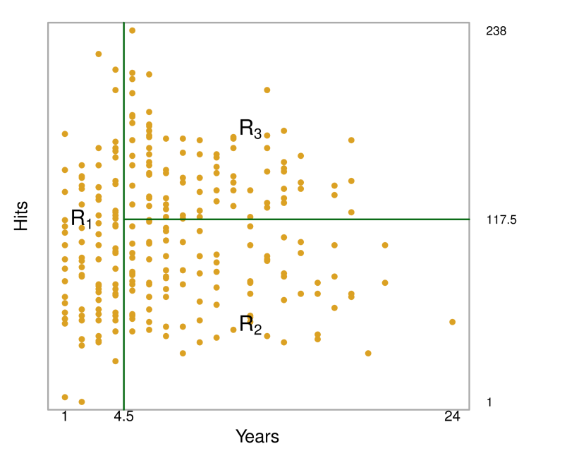
Terminology for Trees
The regions R₁ , R₂, and R₃ are called terminal nodes or leaves
The points along the tree where the predictor space is split are internal nodes.
The segments of the trees that connect the nodes are branches

Slide 8
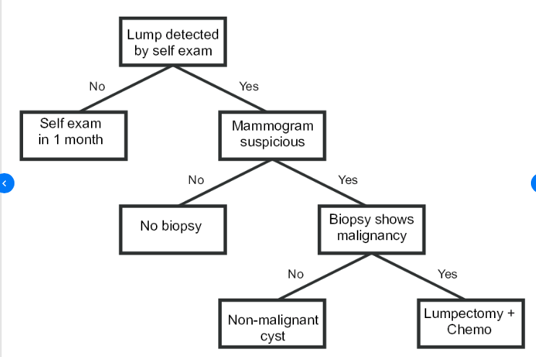

Slide 9
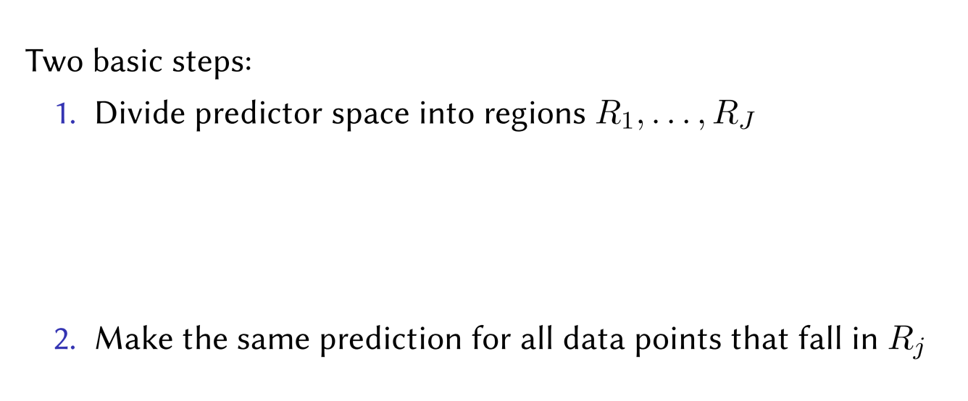
Details of the Tree-Building Process

Slide 10
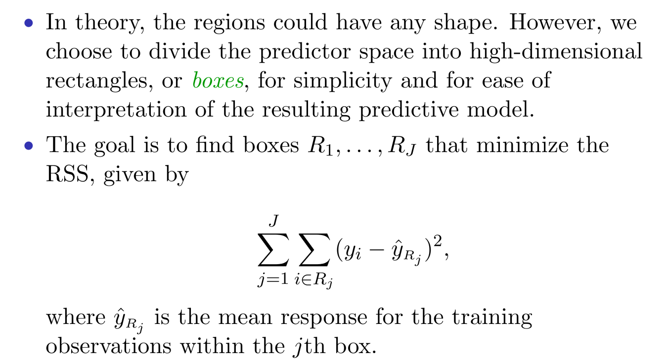
Details of the Tree-Building Process

Slide 11
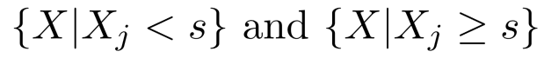
Details of the Tree-Building Process
1. Select the predictor X_{j} and the cut-point s to split the space into , which leads to the largest reduction in RSS
2. Repeat the process looking for the best predictor and cut-point to split the data further minimizing RSS.
3. This process continues until a stopping criterion is reached.
No region has more than 5 data points
The reduction of training RSS is less than a threshold.

Slide 12
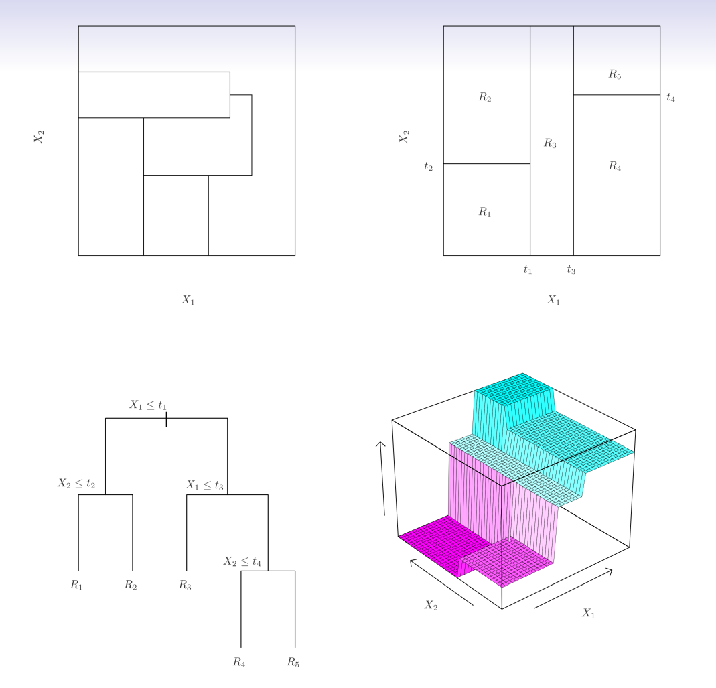
Example

Slide 13
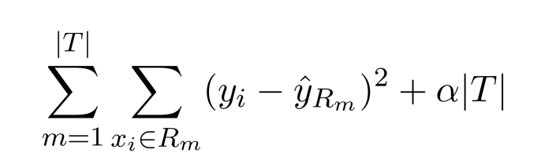
Details of the Tree-Building Process
Any problem with previous procedure if we only minimize RSS?
A smaller tree will have (?) variance and (?) bias, and better interpretation.
(1) Grow and stop; (2) Grow and prune ?
Grow and prune (Cost complexity pruning) is a better choice
|T| indicates the number of terminal nodes of the tree T.

Slide 14
Bonus Quiz 25
A smaller tree will have high/low variance and larger/smaller bias?

Slide 15
Parameter Tuning
The tuning parameter controls the subtree’s complexity
We select an optimal tuning parameter using cross-validation
We then use the selected tuning parameter to the full dataset and obtain the subtree.

Slide 16
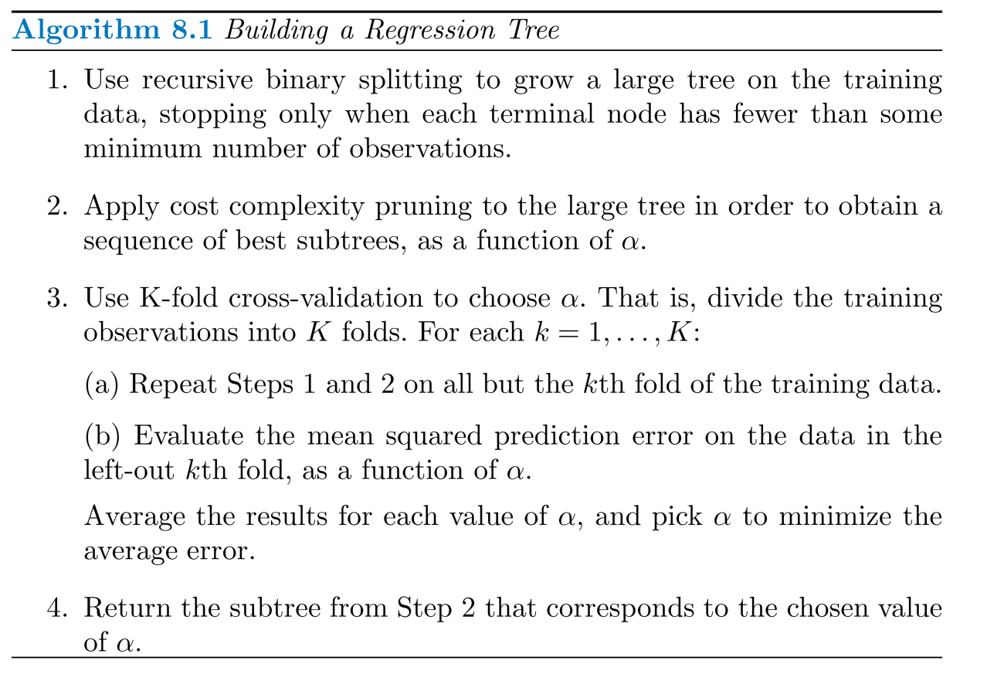
Summary

Slide 17
Baseball Example
Randomly split the data in half with 132 observations as training and 131 observations as testing set.
Built a large regression tree on all of the training data and varied α to create subtrees with different number of terminal nodes.
Performed six-fold cross-validation to estimate the cross-validated MSE of the trees as a function of α.

Slide 18
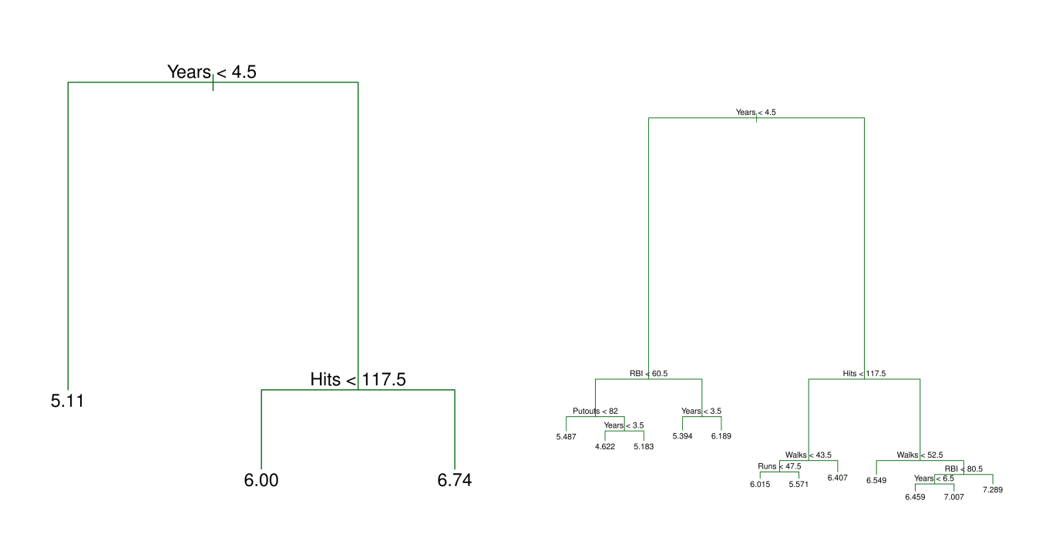
Baseball Example

Slide 19
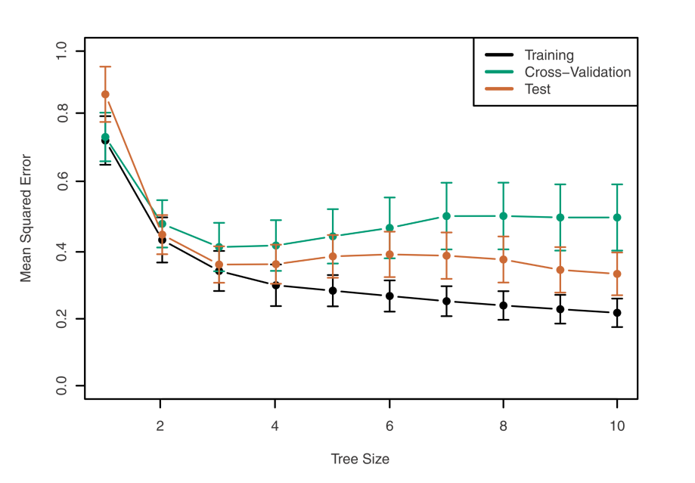
Baseball Example

Slide 20
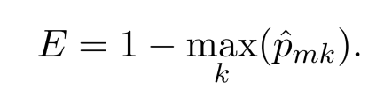
Classification Tree
Similar to a regression tree.
Replace continuous response with qualitative response.
For each box, we predict that each observation belongs to the most commonly occurring class of the training data.
RSS is not suitable. We can use the classification error rate.
But it is not sufficiently sensitive for tree-growing.

Slide 21
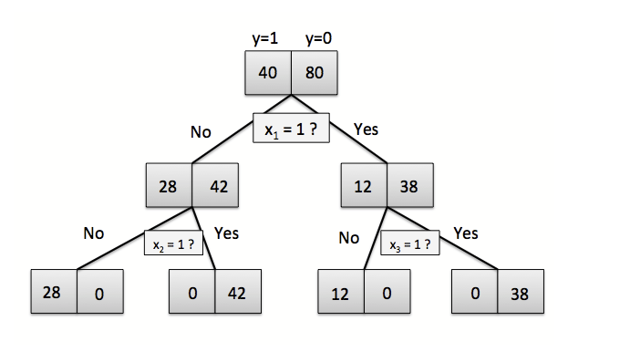
Classification Tree

Slide 22
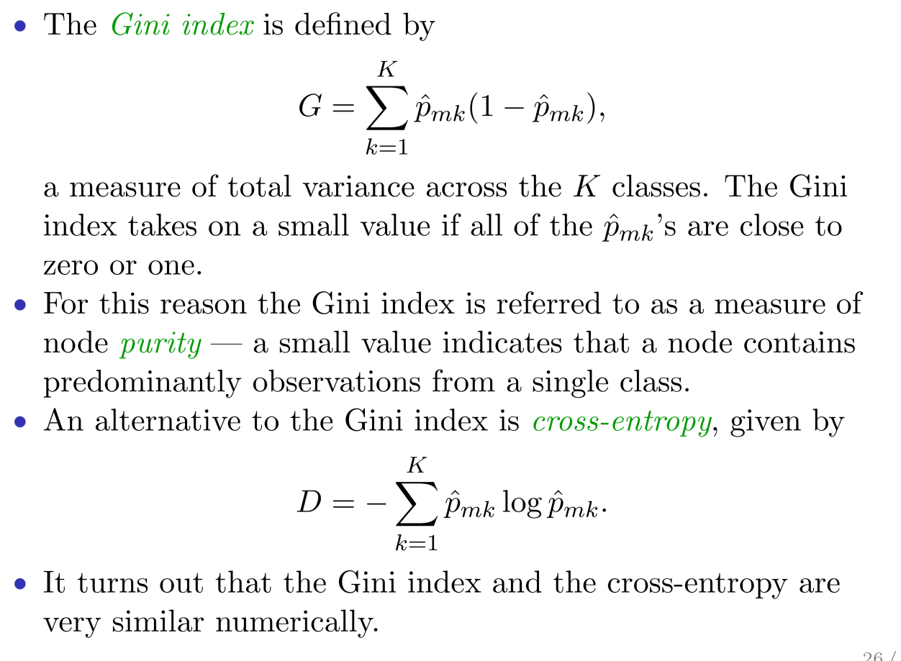
Gini Index and Cross-Entropy

Slide 23
Classification Tree

Slide 24
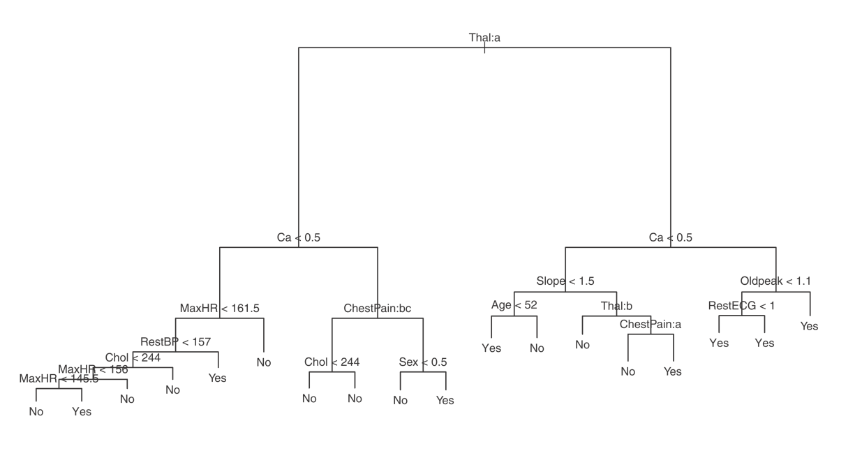
Heart Data
Binary outcome HD (1 is yes, 0 is no) for 303 patients with chest pain.
There are 13 predictors including Age, sex, Cholesterol, etc.
Some of the predictors are qualitative.

Slide 25
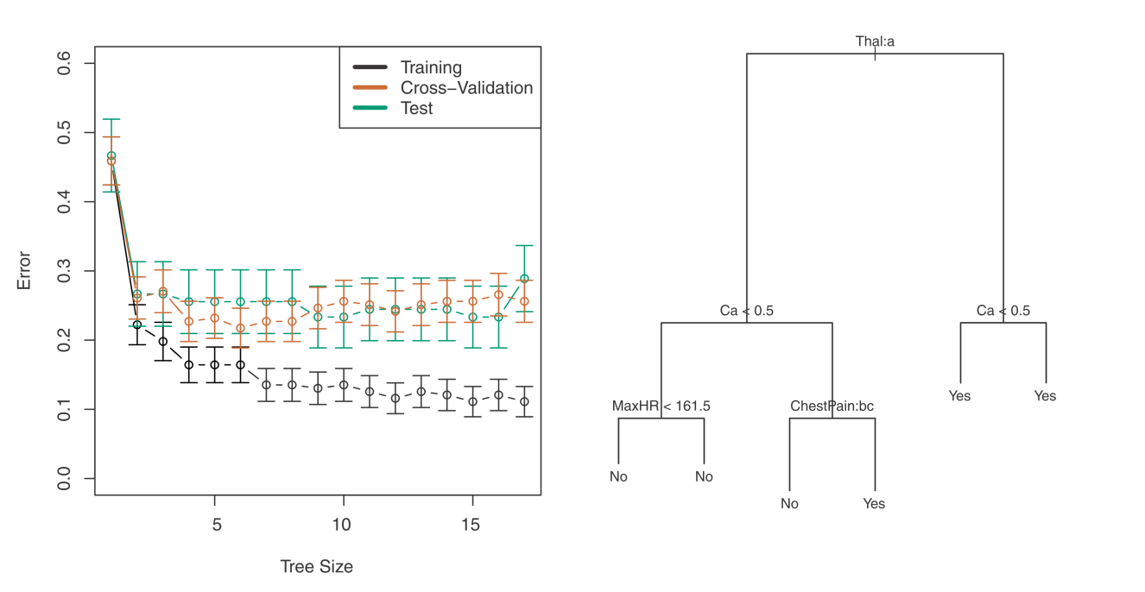
Heart Data

Slide 26
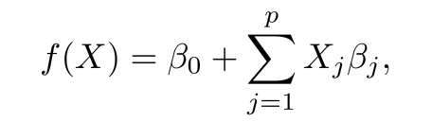
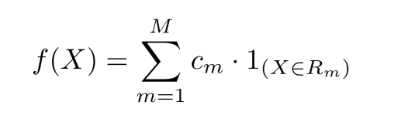
Tree vs Linear Models
Linear model assumes:
Regression trees assumes:

Slide 27
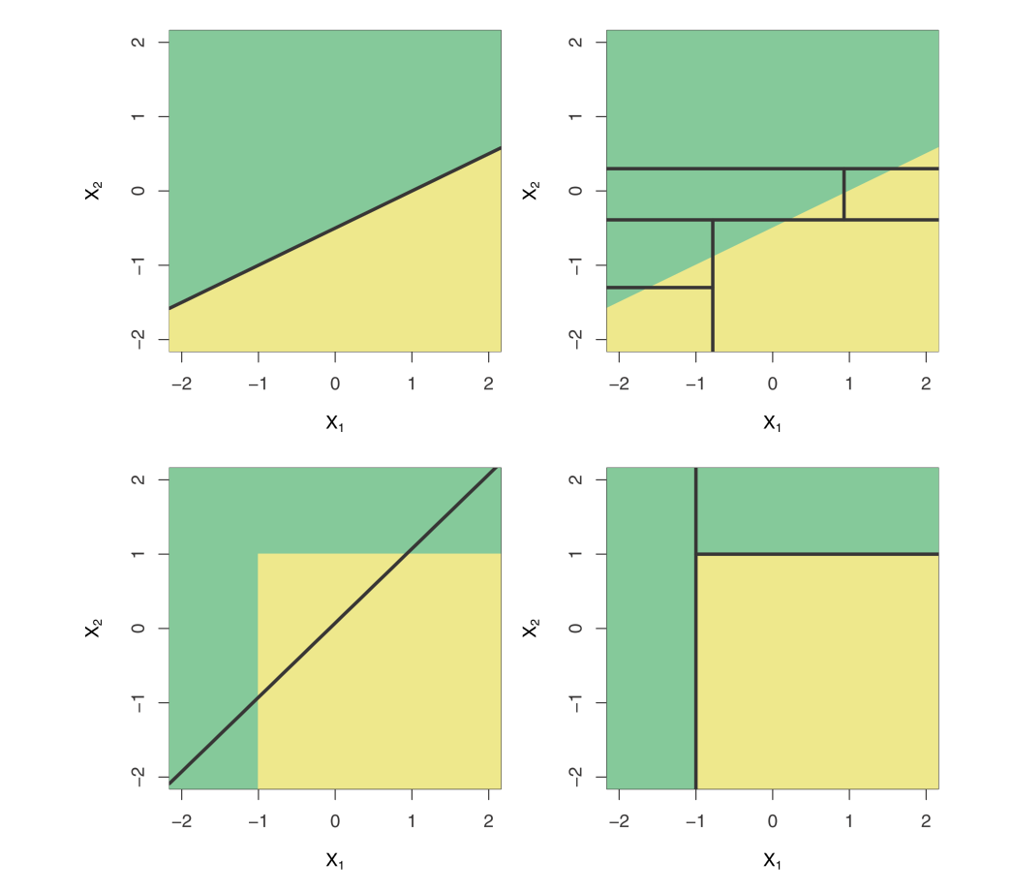
Tree vs Linear Models

Slide 28
Pros and Cons for Trees
Easy to explain.
Can be displayed graphically.
Tree can easily handle qualitative predictors.
Not accurate….mainly due to high variance for deep trees
We can aggregate many decision trees to boost the accuracy.

Slide 29
Bagging (Boostrap aggregation)
Bagging is used to reduce the variance of a statistical learning method （e.g. decision trees)
Averaging a set of observations can reduce variance. But how to?
Use Bootstrap! We can generate many sets of data.

Slide 30
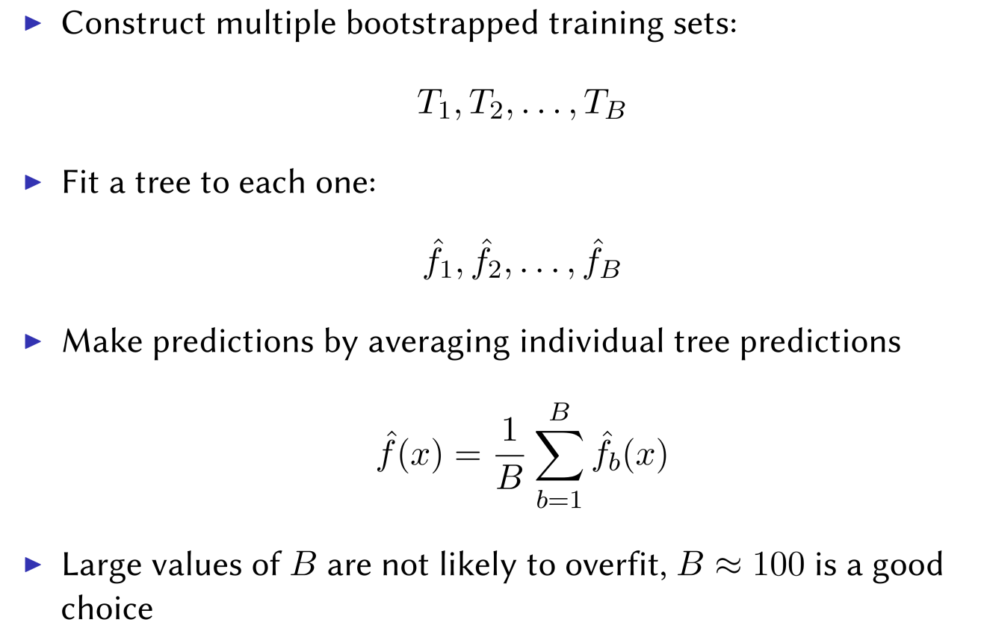
Bagging for Regression Trees

Slide 31
Bagging for Classification Trees
For classiﬁcation trees: for each test observation, we record the class predicted by each of the B trees and take a majority vote: the overall prediction is the most commonly occurring class among the B predictions.

Slide 32
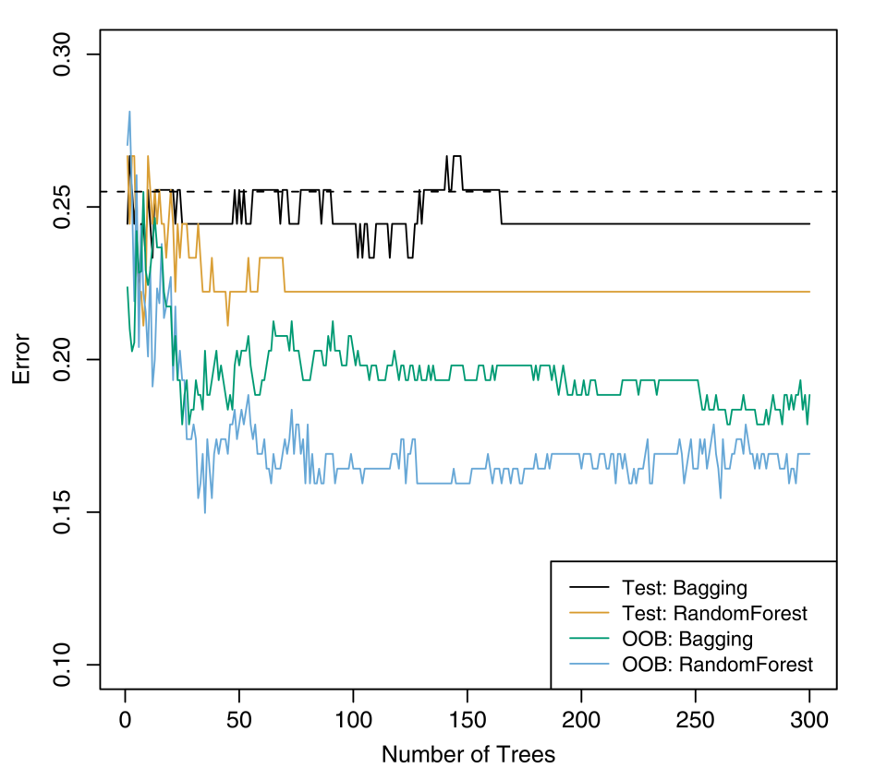
Bagging for the Heart Data

Slide 33
Out-of-Bag Error Estimation
How to estimate the test error of a bagged model.
Recall that on average each bagged tree makes use of around 2/3 of the observations.
The remaining 1/3 of the observations not used to ﬁt a given bagged tree are referred to as the out-of-bag (OOB) observations.
We can predict the response for the ith observation using each of the trees in which that observation was OOB. This will yield around B/3 predictions for the ith observation, which we average.
This estimate is essentially the LOO cross-validation error for bagging, if B is large.

Slide 34
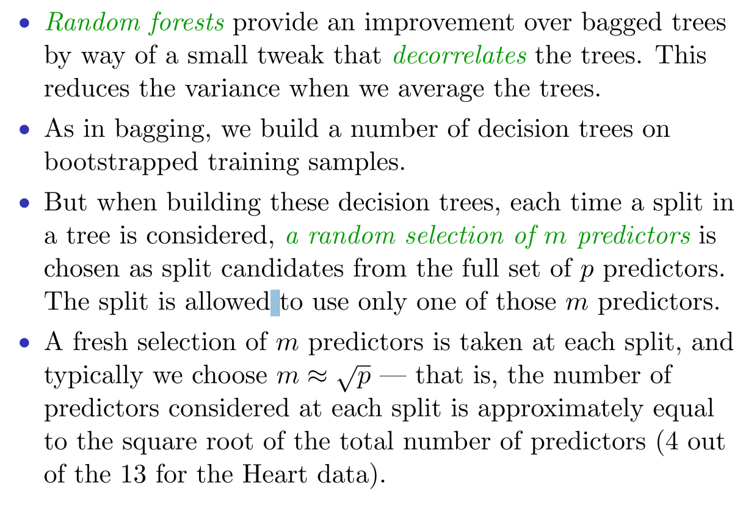
Random Forest

Slide 35
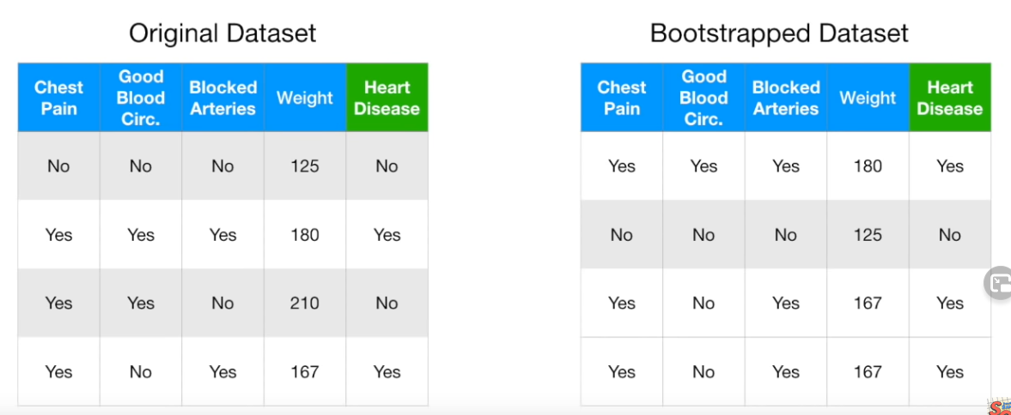
Random Forests
Step 1: Create a boostrapped dataset
From statquest.com

Slide 36
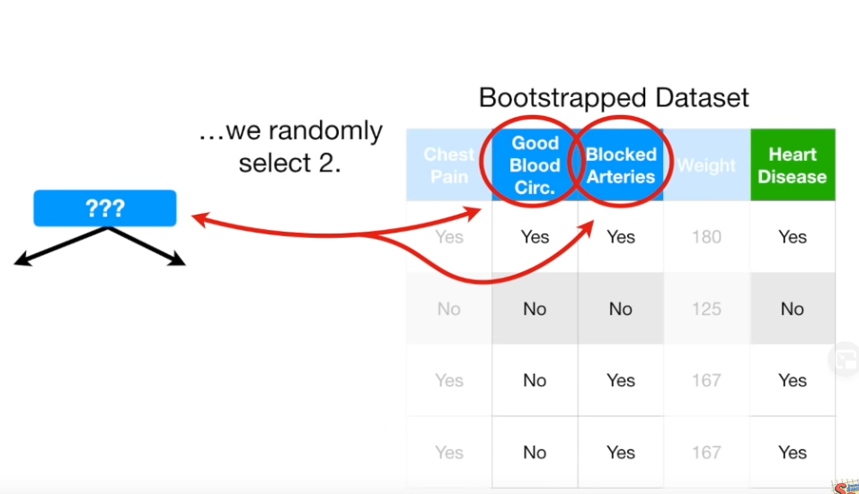
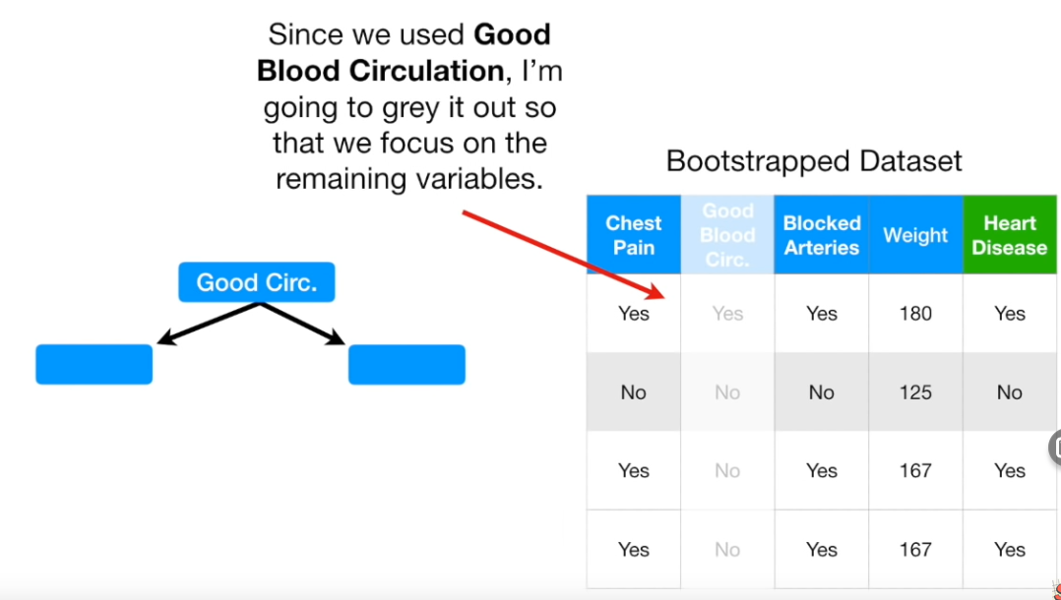
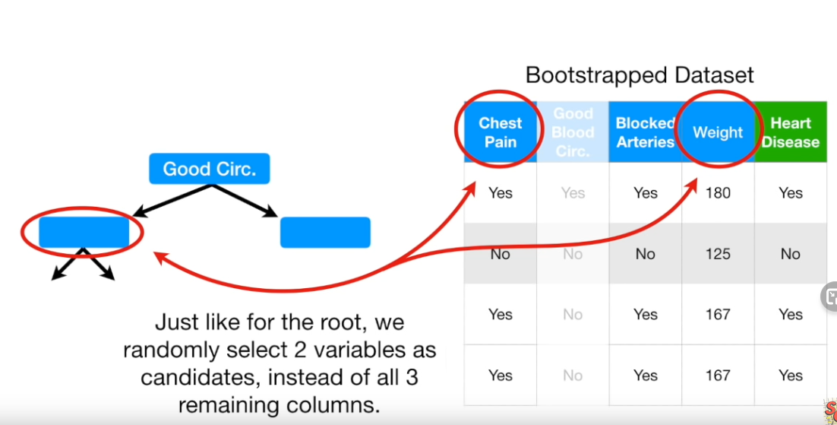
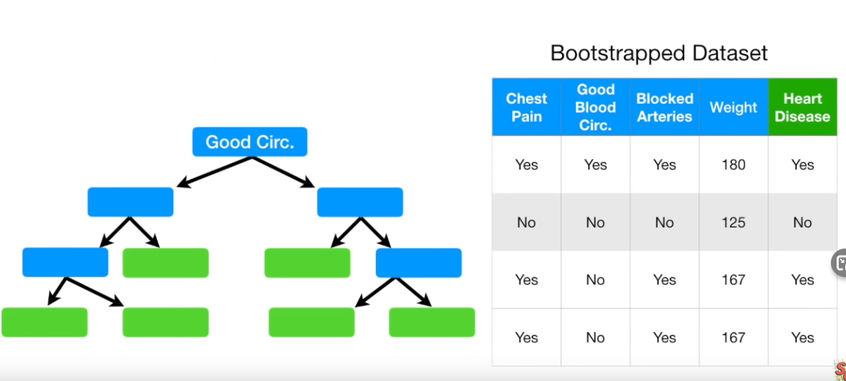
Build a Random Forest Classifier
Step2: Create a decision tree using the bootstrapped dataset, but only use a random subset of variables (columns) at each step
From statquest.com

Slide 37
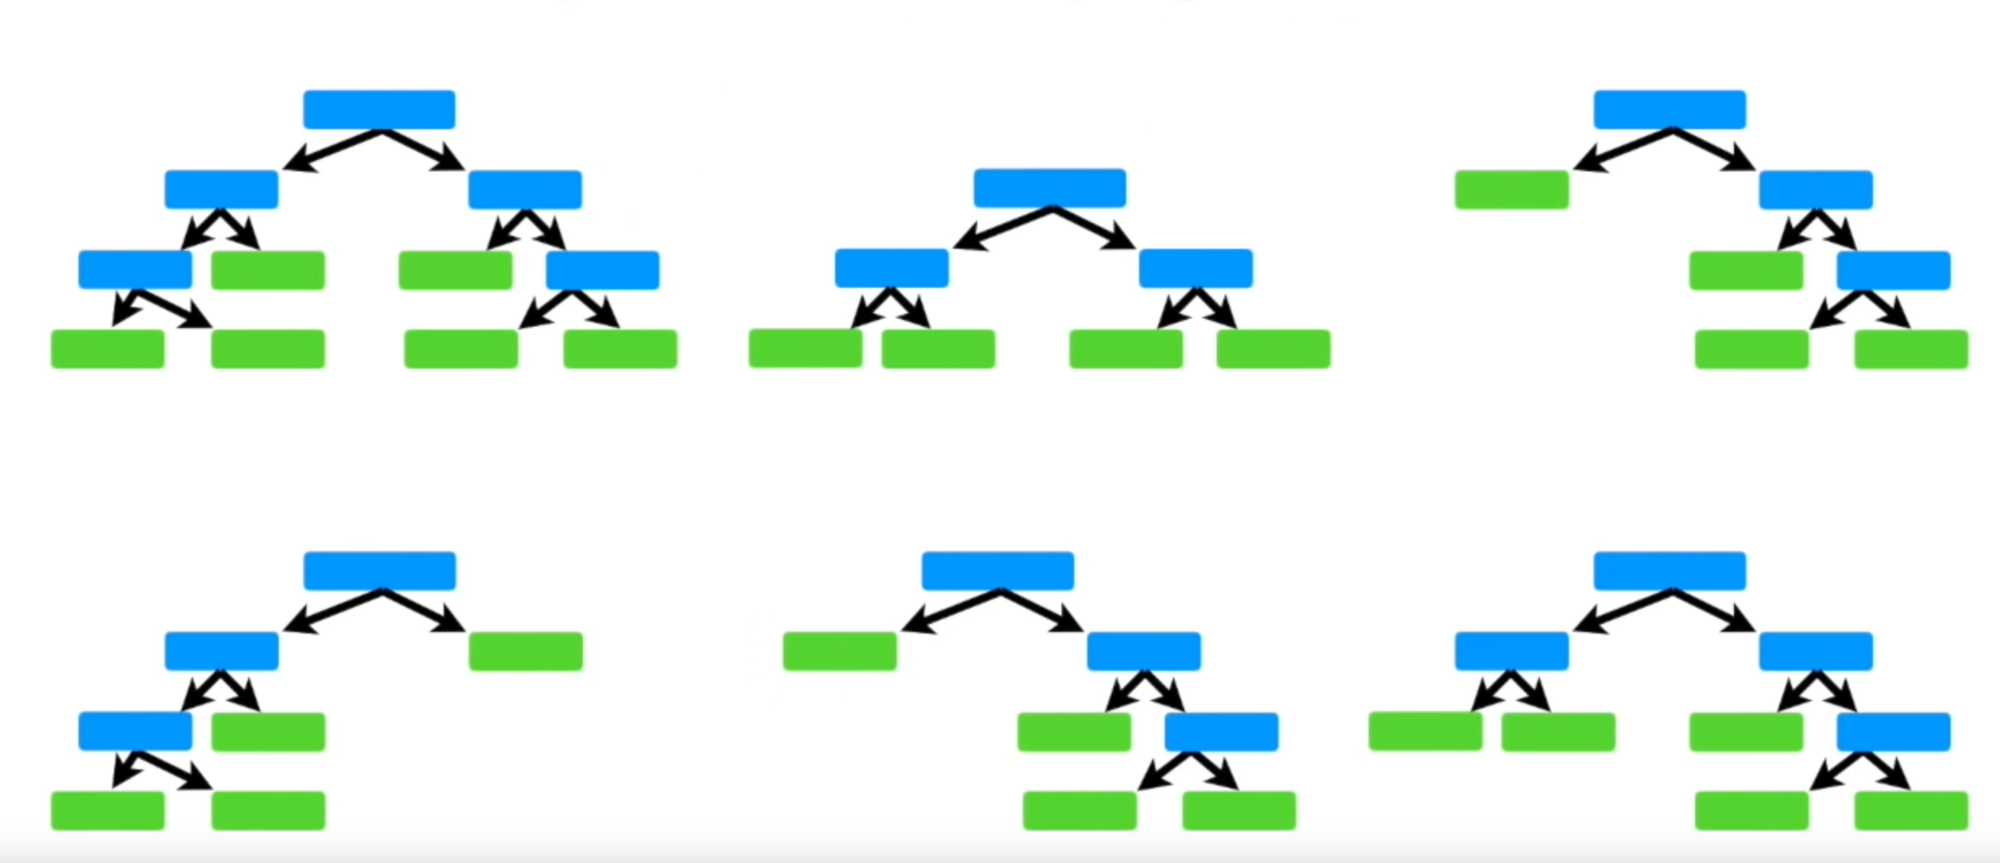
Build a Random Forest Classifier
Step3: Repeat Steps 1-2 and generate B trees
From statquest.com

Slide 38
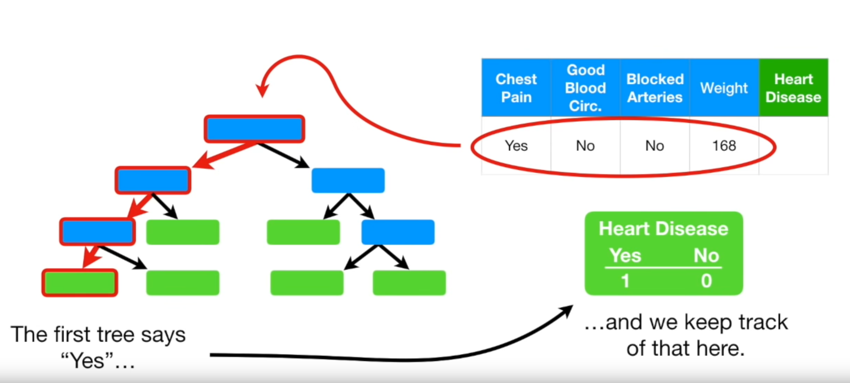
Build a Random Forest Classifier
How to use it?
From statquest.com

Slide 39
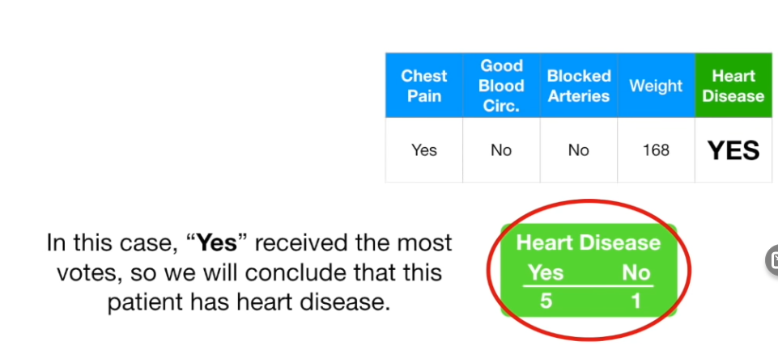
Build a Random Forest Classifier
How to use it?
From statquest.com

Slide 40
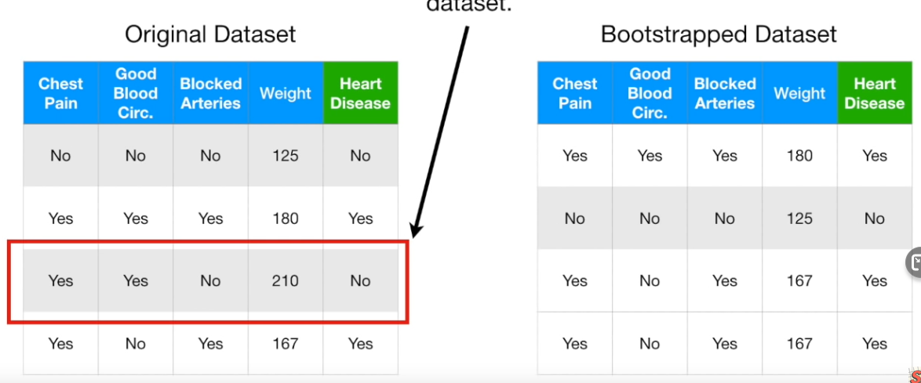
How to Evaluate the Performance?
From statquest.com

Slide 41
How to Evaluate the Performance?
From statquest.com

Slide 42
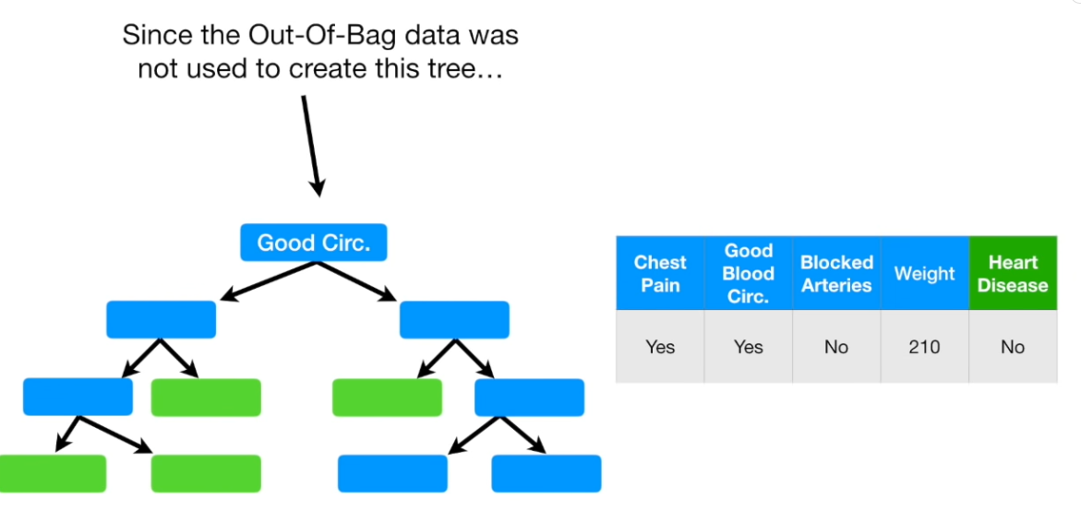
How to Evaluate the Performance?
From statquest.com

Slide 43
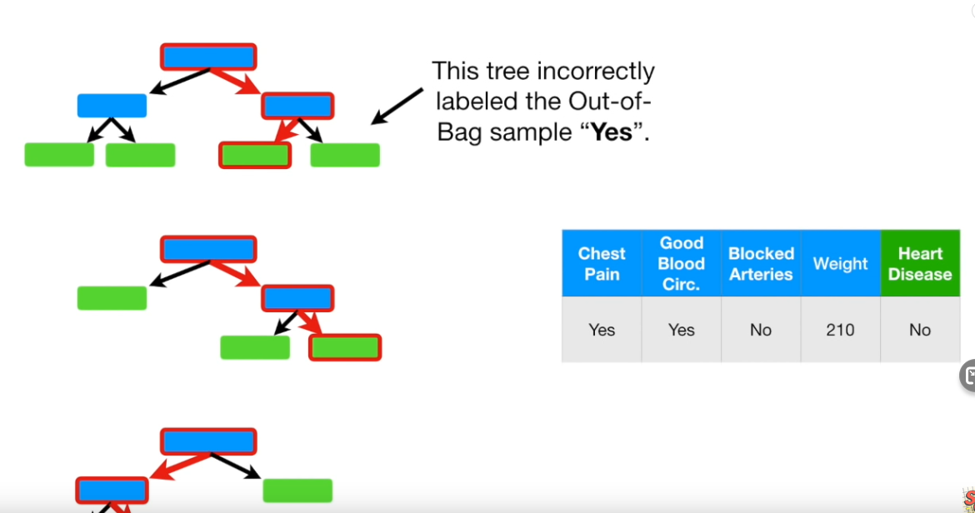

Slide 44
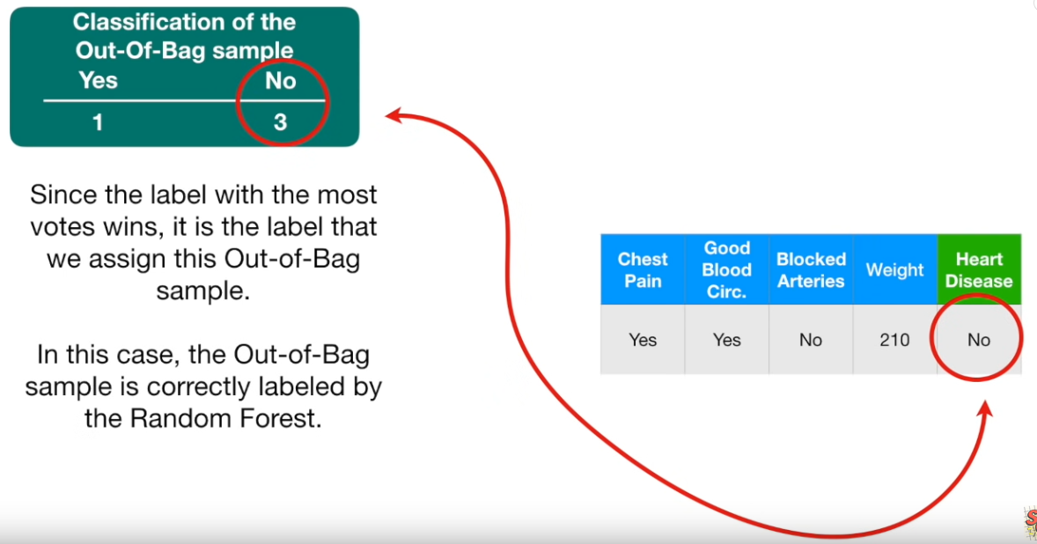

Slide 45
We then repeat this procedure for the other Out-Of-Bag samples for all the corresponding trees.
We then can measure how accurate our random forest is by proportion of Out-Of-Bag samples that were correctly classified by the Random Forrest.
The proportion of Out-Of-Bag samples that were incorrectly classified is the ‘Out-Of-Bag Error’

Slide 46
Example: Gene Expression
This dataset consists expression of 4718 gene from 349 patients
Each patient has a qualitative label with 15 different levels: either normal or one of 14 different types of cancer.
We apply random forests to predict cancer type based on 500 most variated genes in the training set.
We randomly divided the observations into a training and a test set, and applied random forests to the training set for three diﬀerent values of the number of splitting variables m.

Slide 47
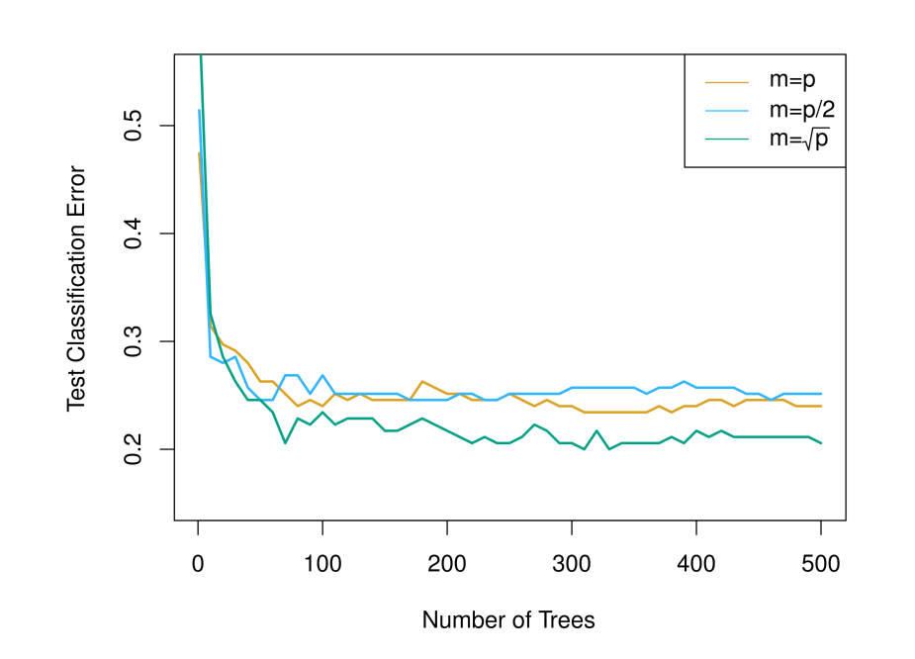
Example: Gene Expression

Slide 48
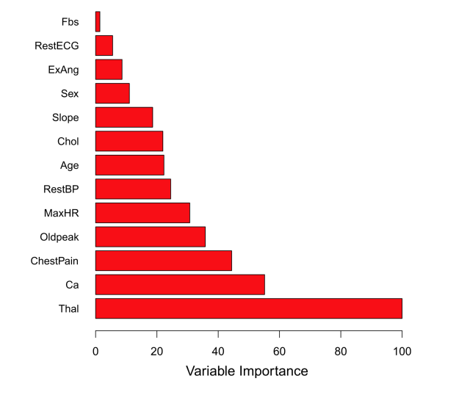
Variable Important Measure
For Bagging and RF, we generate a lot of trees, which makes it hard to interpret.
For bagged/RF regression trees, we record the total amount that the RSS is decreased due to splits over a given predictor, averaged over all B trees. A large value indicates an important predictor.
Similarly, for bagged/RF classiﬁcation trees, we add up the total amount that the Gini index is decreased by splits over a given predictor, averaged over all B trees

Slide 49
Boosting
Boosting is a general framework. We focus on decision tree here.
Unlike bagging, Boosting works in a sequential way: each tree is grown using information from previous grown trees.

Slide 50
Boosting
Boosting is a general framework. We focus on decision tree here.
Unlike bagging, Boosting
doesn’t uses bootstrapped data
works in a sequential way: each tree is grown using information from previous grown trees.
uses small trees.

Slide 51
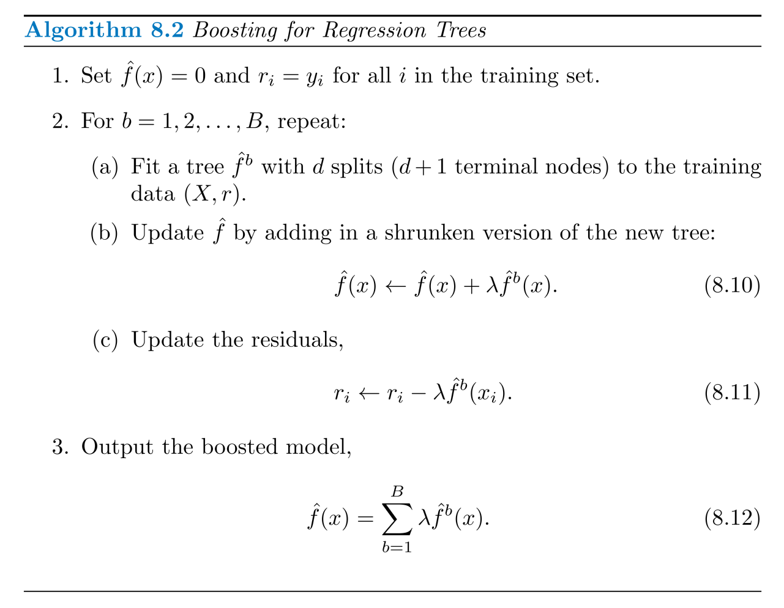
Boosting for Regression Trees

Slide 52
Idea behind Boosting
Boosting approach learns slowly.
Given the current model, we ﬁt a decision tree to the residuals from the model. We then add this new decision tree into the ﬁtted function to update the residuals.
Each of these trees can be rather small, with just a few terminal nodes, determined by the parameter d in the algorithm.
By ﬁtting small trees to the residuals, we slowly improve the model in areas where it does not perform well. The shrinkage parameter λ slows the process down even further, allowing more and diﬀerent shaped trees to attack the residuals.

Slide 53
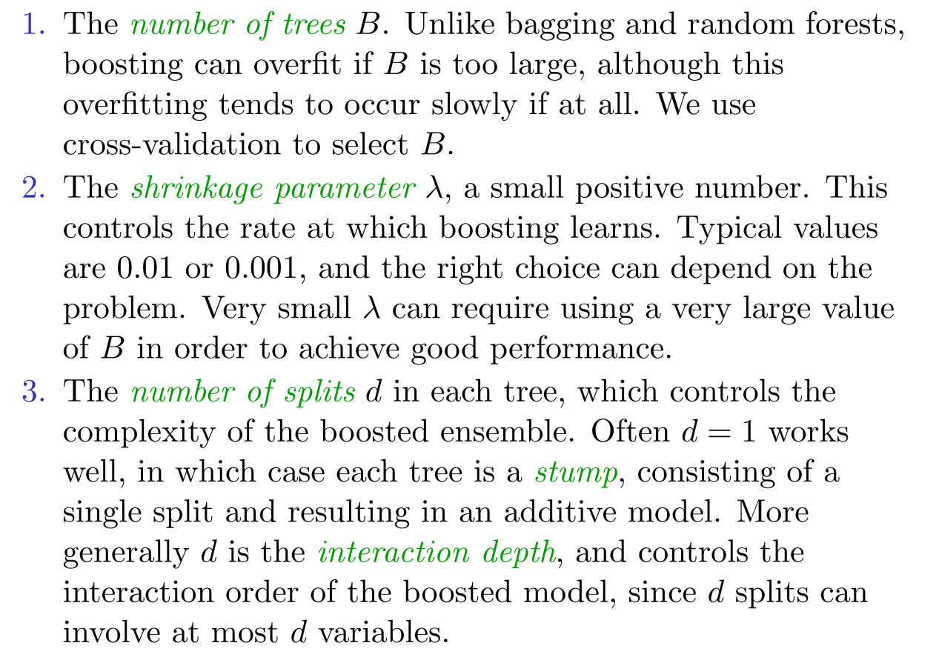
Tuning Parameters for Boosting

Slide 54
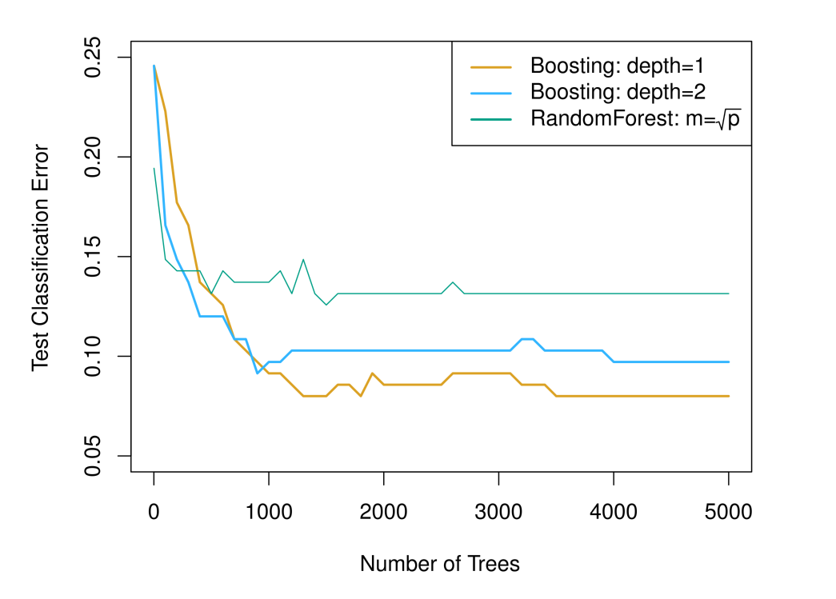
Gene Expression Data

Slide 55
Summary
Decision trees are simple and interpretable models for regression and classiﬁcation but not very competitive.
Bagging, RF and boosting are good methods for improving the prediction accuracy of trees.
Bagging and RF work by growing many deep trees on the boostrapped data sets and then combining the predictions of the resulting ensemble of trees.
Boosting works by sequentially add small trees.

